Slide 1


Ceyhan Akdam
30.07.2023

Slide 2

Outline
Executive Summary
Introduction
Methodology
Results
Conclusion
Appendix

Slide 3
Executive Summary
Summary of methodologies
Visualization and Analyzing methodologies were applied on the Space X Mission Data. With the help of Exploratory Analysis (EDA) and Web Scraping tools the data went through some Data Science process. Additionally, Folium Maps and some other ML – Machine Learning techniques were applied on the data.
Summary of all results
All the necessary Data Science and Analysis tools such as EDA, ML, Visualization methodologies, and mainly the data collection and data framing analysis provided a trustworthy and deep understanding in the data of SpaceX. The overall results gave a deep understanding in launch sites, landing outcomes, success rates and payloads, and the relationship between each other.

Slide 4
Introduction
Data provided by SpaceX API was observed through some data science methodologies, and the results were recorded for further decisions.
Understanding the relationship between payload mass and launch outcomes
• Analyzing the impact of different launch sites on the success rate
Investigating the trend of launch success over time; • Evaluating the performance of different machine learning algorithms for predicting launch outcomes; • Identifying any significant differences in success rates based on the type of orbit; and • Analyzing the relationship between launch success and specific landing pad locations.

Slide 5

Section 1

Slide 6
Methodology
Executive Summary
Data collection methodology:
Perform data wrangling
Perform exploratory data analysis (EDA) using visualization and SQL
Perform interactive visual analytics using Folium and Plotly Dash
Perform predictive analysis using classification models
How to build, tune, evaluate classification models

Slide 7
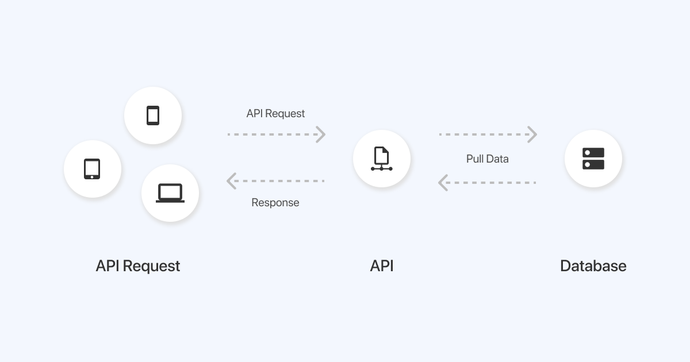
Data Collection
Data was obtained from SpaceX Website
Web Scraping is used on Falcon9 launch data.

Slide 8
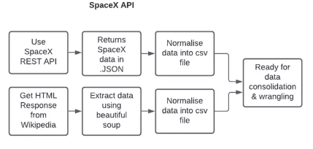
Data Collection – SpaceX API
GitHub URL OF Data Collection:
https://github.com/ceyk79/DataScienceIBM/blob/main/ceyk_datacollection.ipynb

Slide 9
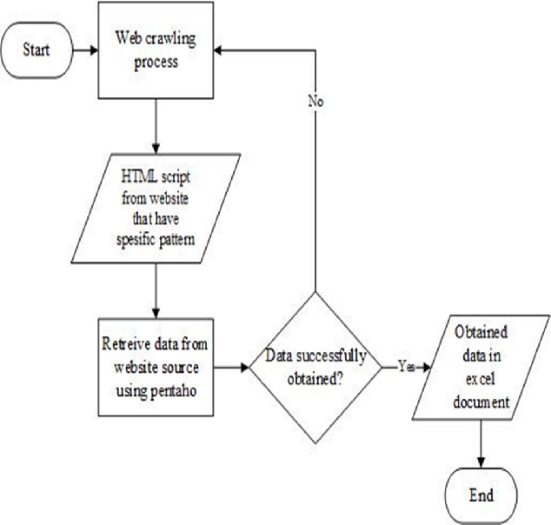
Data Collection - Scraping
GitHub URL: https://github.com/ceyk79/DataScienceIBM/blob/main/ceyk_webscraping.ipynb

Slide 10
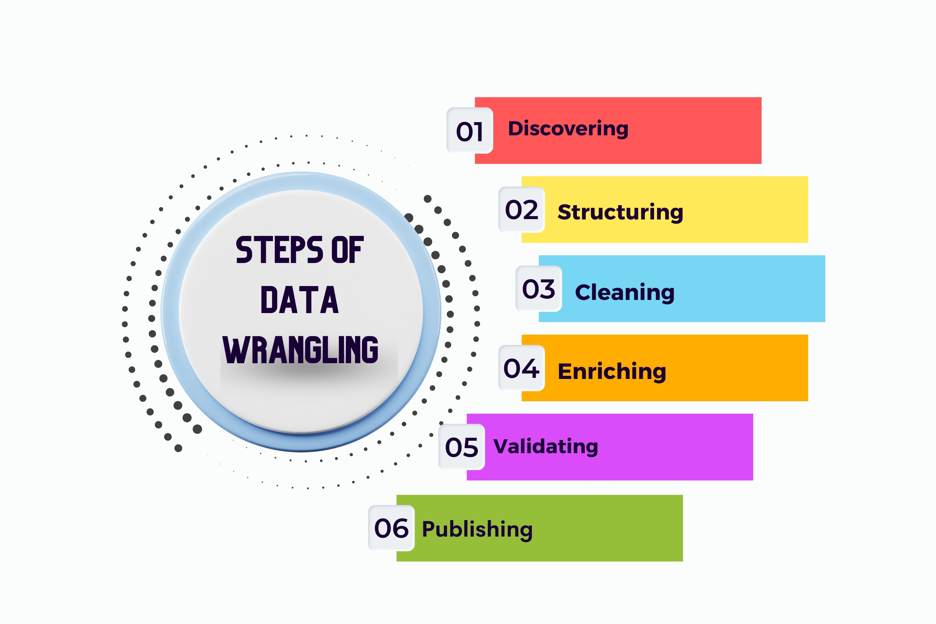
Data Wrangling
Standardized data formats and units to ensure consistency.
Transformed data types and structures.
Through Feature Engineering: new variables or extract information.
Cleaned duplicates and handled missing values.
https://github.com/ceyk79/DataScienceIBM/blob/main/ceyk_wranling.ipynb

Slide 11
EDA with Data Visualization
Using a scatter plot, you can see how two variables are related to each other.
LaunchSite and FlightNumber are used to look for any patterns or trends.
Bar chart: Used to compare the performance of various orbital kinds by displaying the success rate of each.
In order to assess the trend and spot any changes or advancements, a line chart was created by plotting the average success rate over time.
The launch sites and successful or unsuccessful launches are marked on a map to facilitate spatial analysis and visualization.
https://github.com/ceyk79/DataScienceIBM/blob/main/ceyk_edaviz.ipynb

Slide 12
EDA with SQL
To get specific columns or records from database tables, use the SELECT command.
Data from different tables can be combined via a JOIN if they have a common column.
GROUP BY: Used to aggregate functions on grouped data and group data based on a certain column.
ORDER BY: Used to arrange the results according to one or more columns, either in ascending or descending order.
SUBQUERY: This query-within-a-query technique enables more complicated data retrieval and analysis.
https://github.com/ceyk79/DataScienceIBM/blob/main/ceyk_edasql.ipynb

Slide 13
Build an Interactive Map with Folium
Markers: The launch locations were marked on the map with additional markers. Each marking designates a particular spot on the launch site.
Circles: Circles were added to show how successful or unsuccessful launches were at each venue. A visual depiction of launch results is provided by the size and color of the circles, which reflect the success rate.
Lines: Additional lines added to link the launch locations, depicting the rockets' flight paths or trajectories.
GITHUB Link:
https://github.com/ceyk79/DataScienceIBM/blob/main/ceyk_map.ipynb

Slide 14
Build a Dashboard with Plotly Dash
Utilizing Plotly dash, create a dynamic dashboard.
Plotted pie charts that display the overall number of launches by particular venues
A plotted scatter graph demonstrating the association between the outcome and the payload mass (Kg) for various booster versions.

Slide 15
Predictive Analysis (Classification)
The data was loaded by using pandas and numpy, converted it, then divided it into training and testing sets.
Using GSV created several machine learning models and adjusted various hyperparameters.
We used accuracy as our model's measure, and we enhanced it through feature engineering and algorithm tweaking.
Recognized the top classification model.
https://github.com/ceyk79/DataScienceIBM/blob/main/ceyk_predictive.ipynb

Slide 16
Results
Exploratory data analysis results
Interactive analytics demo in screenshots
Predictive analysis results

Slide 17

Section 2

Slide 18
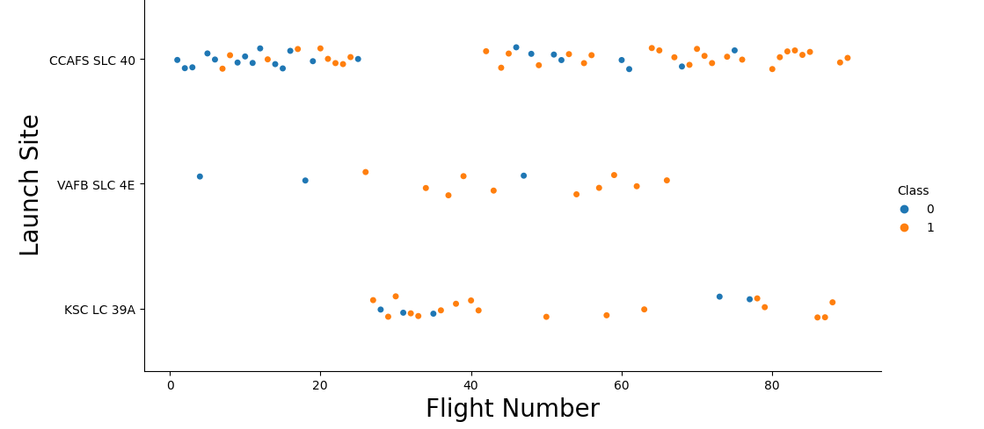
Flight Number vs. Launch Site
Approximitely after the flight number 80, class is 1 which means 100% success rate

Slide 19
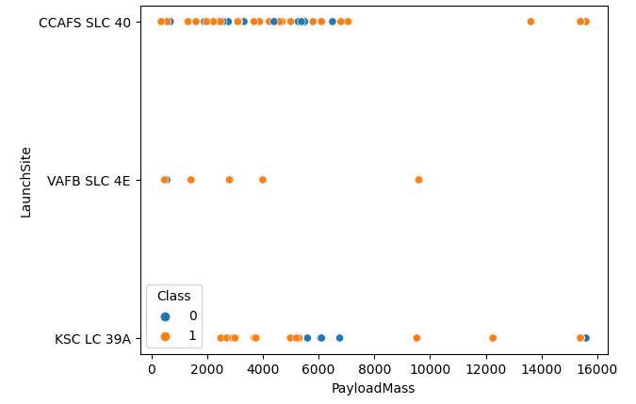
Payload vs. Launch Site
There are no rockets launched for heavypayload mass(greater than 10000).

Slide 20
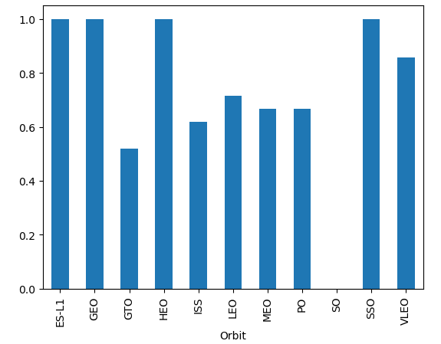
Success Rate vs. Orbit Type
The ES-L1, GEO, HEO and SSO orbit have the maximum success rate

Slide 21
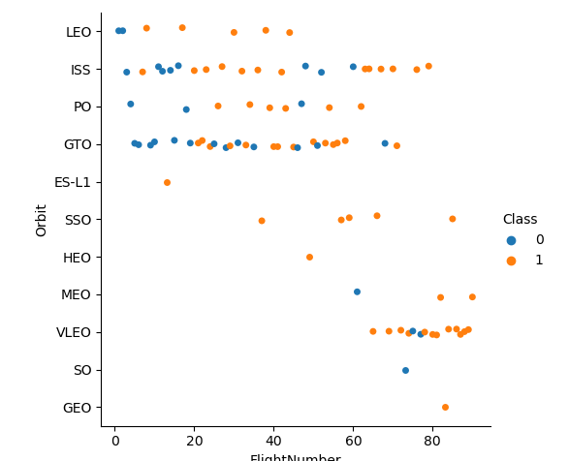
Flight Number vs. Orbit Type
There seems to be no relationship between flight number when in GTO orbit.

Slide 22
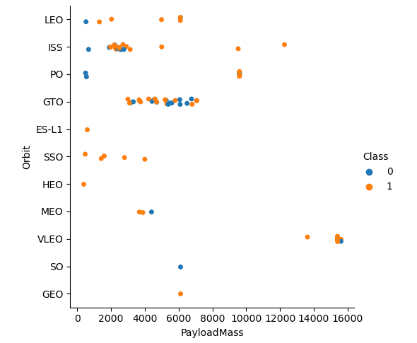
Payload vs. Orbit Type
With heavy payloads the successful landing or positive landing rate are more for Polar,LEO and ISS.
However for GTO we cannot distinguish this well as both positive landing rate and negative landing (unsuccessful mission) are both there here.

Slide 23
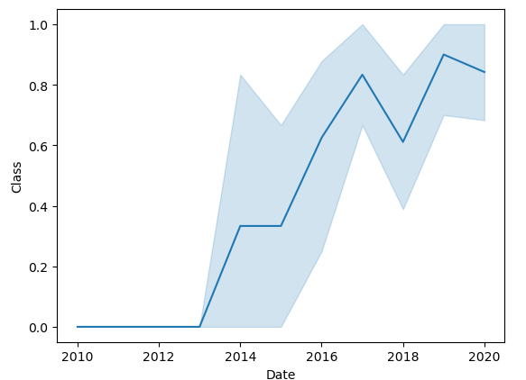
Launch Success Yearly Trend
The success rate since 2013 kept increasing till 2020

Slide 24
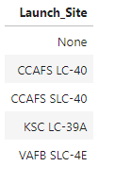
All Launch Site Names
Launch Sites Are:
CCAFS LC-40
VAFB SLC-4E
KSC LC-39A
CCAFS SLC-40

Slide 25
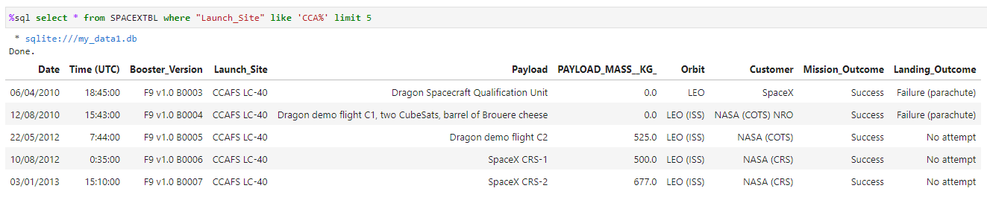
Launch Site Names Begin with 'CCA'
Launch Sites starting with CCA are found and limited by 5 to obtain the list below:

Slide 26
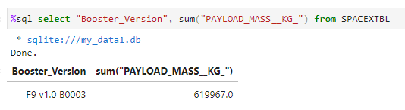
Total Payload Mass
The sum of payload mass is found

Slide 27
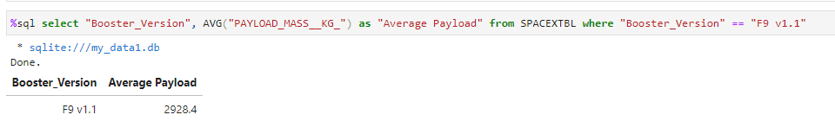
Average Payload Mass by F9 v1.1
The average payload mass carried by booster version F9 v1.1 is 2928.4 KG

Slide 28
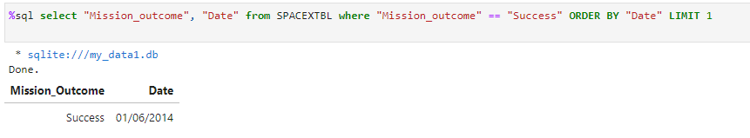
First Successful Ground Landing Date
The first successful landing outcome on ground pad is 01.06.2014

Slide 29
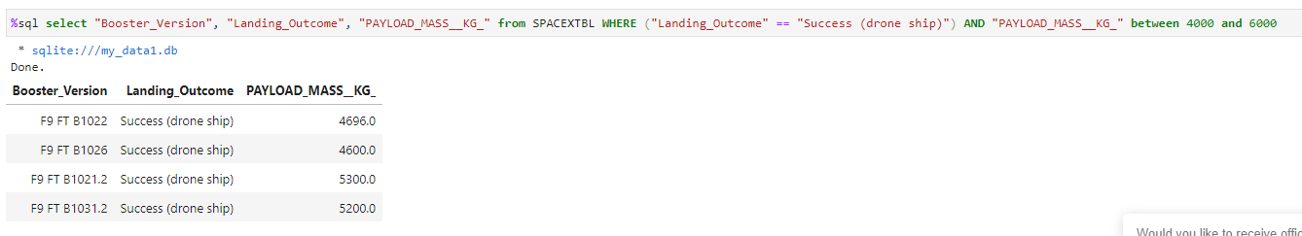
Successful Drone Ship Landing with Payload between 4000 and 6000
List the names of boosters which have successfully landed on drone ship and had payload mass greater than 4000 but less than 6000
Below you ´find the list:

Slide 30
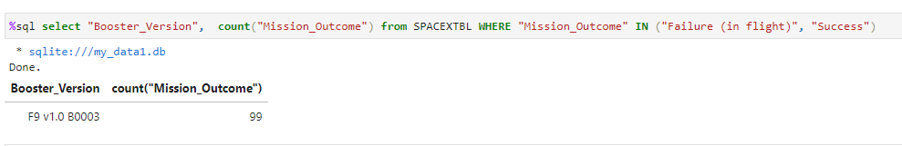
Total Number of Successful and Failure Mission Outcomes
The number of successful and failure mission outcomes

Slide 31
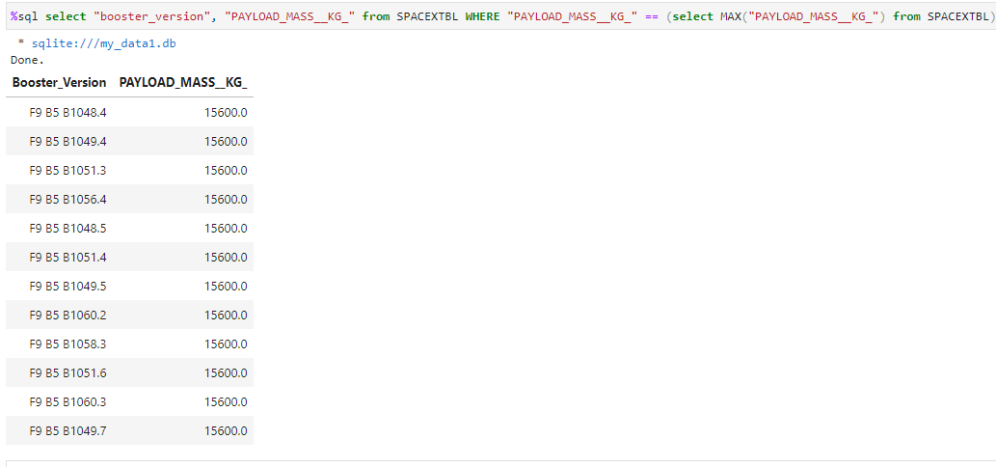
Boosters Carried Maximum Payload
List the names of the booster which have carried the maximum payload mass
A Subquery technique is used as follows:

Slide 32
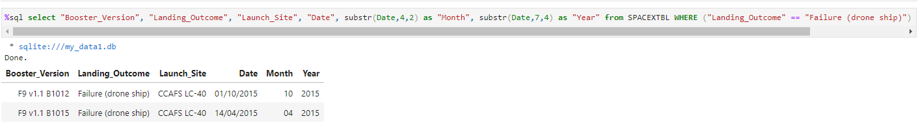
2015 Launch Records
The failed landing_outcomes in drone ship, their booster versions, and launch site names for in year 2015:

Slide 33
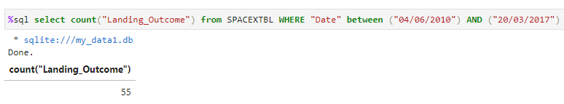
Rank Landing Outcomes Between 2010-06-04 and 2017-03-20
Rank the count of landing outcomes (such as Failure (drone ship) or Success (ground pad)) between the date 2010-06-04 and 2017-03-20, in descending order

Slide 34

Section 3

Slide 35
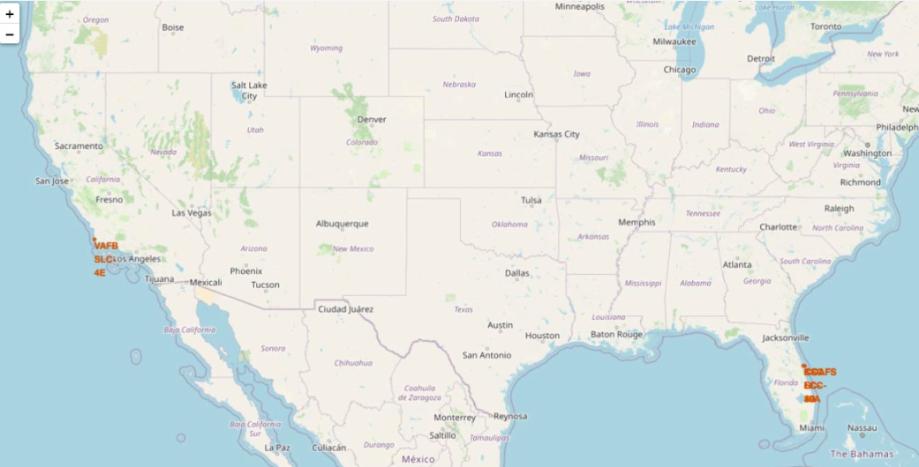
<Folium Map Screenshot 1>

Slide 36
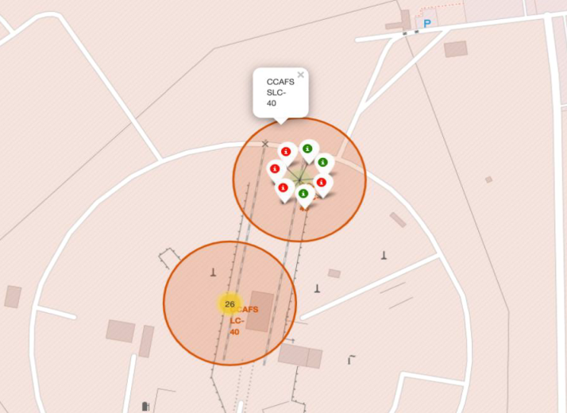
<Folium Map Screenshot 2>

Slide 37
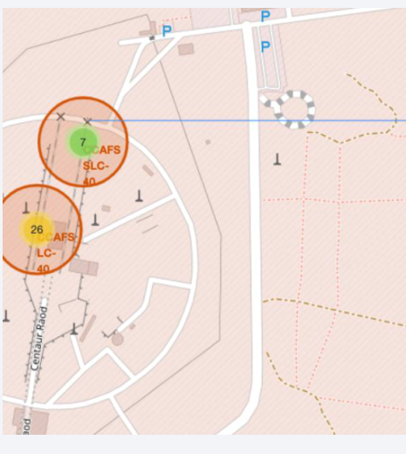
<Folium Map Screenshot 3>

Slide 38

Section 4

Slide 39
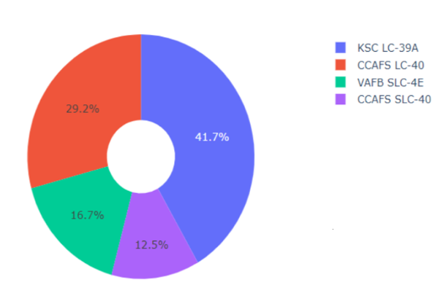
<Dashboard Screenshot 1>
KSC LC-39A has 41.7% pie so the most successful launches

Slide 40
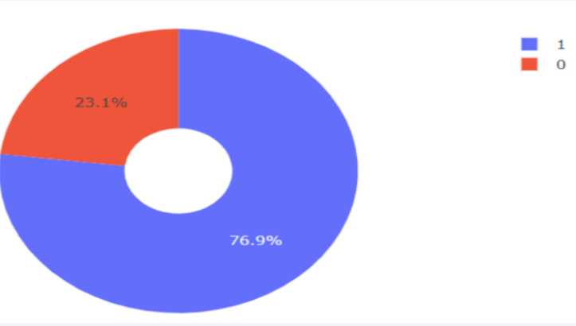
<Dashboard Screenshot 2>
Successful launches are 76.9% of overall launches

Slide 41
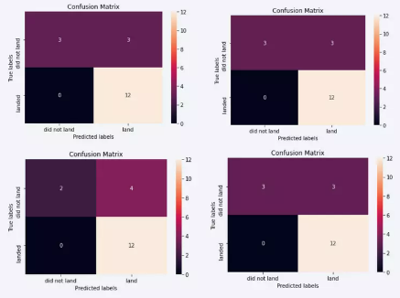
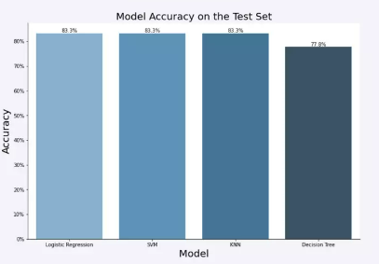
<Dashboard Screenshot 3>
Logistic Regression showed the highest accuracy rate as 83.3%

Slide 42

Section 5

Slide 43
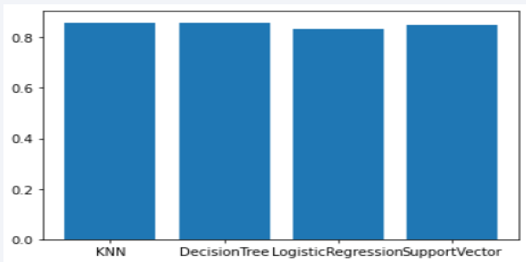
Classification Accuracy
Visualization of the built model accuracy for all built classification models, in a bar chart
KNN model has the highest classification accuracy.

Slide 44
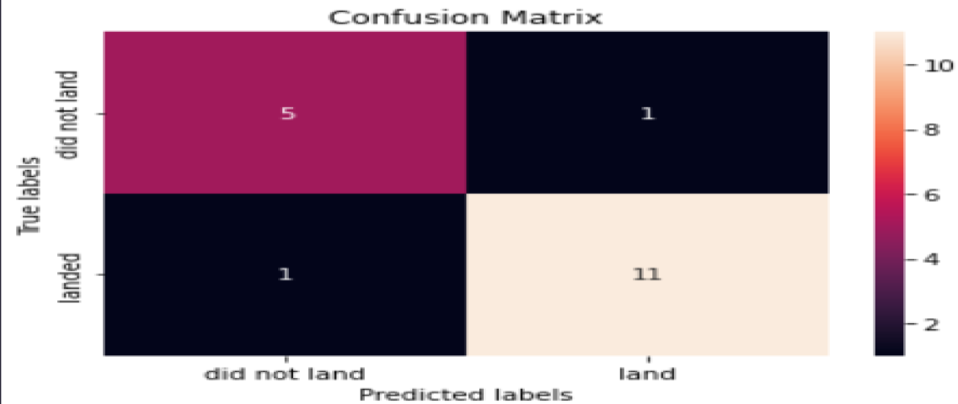
Confusion Matrix
Show the confusion matrix of the best performing model with an explanation

Slide 45
Conclusions
The launch success rate increased from 2013 to 2020.
GEO, HEO, SSO, and VLEO orbits had the highest success rates.
KSC LC-39A had the most successful launches.
The success rate at a launch site increases with the size of the flight amount.
KNN showed the best practise.

Slide 46
Appendix

Slide 47


